Slide 1

EE450 Discussion #5
Wednesday, September 29th, 2010
Shannon’s Theorem
Nyquist Theorem
Modulations
Multiplexing

Slide 2

Shannon’s Theorem
C = B log₂(1 + SNR)
Theoretical Maximum Capacity that can be obtained on a line
Sets an Upper Bound on the capacity given the conditions
  Used for Calculating the
    Signal to Noise Ratio – Given the Bandwidth and capacity of the channel
    Bandwidth - Given the SNR and Channel Capacity
    Capacity - Given the SNR and the Bandwidth

Slide 3
Problem #1
What SNR is needed to put a T-1 carrier on a 50 khz line?
  What do we know?
    T-1 Capacity = 1.544 Mbps
    Bandwidth = 50 KHz
  Move them around and Solve:
    1,544,000 = 50,000 log 2 (1+SNR)
    2^30.88 –1 = SNR

Slide 4
Continued
So SNR = 1976087931
  SNR is typically measured in DB
    Use SNR dB = 10 log ₁₀ (SNR)
  In this case
    SNR dB = 10 log ₁₀ (1976087931)
    SNR aprox. 92.9 dB
  However you must NOT plug SNR into Shannon’s theorem in dB format

Slide 5
Problem #2
Calculate the maximum rate supported by a telephone line with BW of 4 KHz. When the signal is 10 volts, the noise is 5 milivolts.
SNR=Signal power/Noise Power
Power is proportional to square of the voltage
S/N = (10^2)/(0.005^2) = 4000000
B = 4000 Hz
C = B log ₂ (1+S/N)
  Reminder: log ₂ x = ln x / ln 2
C = 4000 log ₂ (1+4000000)= 87726 bps

Slide 6

Nyquist Theorem
The Case of a clean channel
C = 2 x B x log ₂ M
C = 2 x B x log ₂ 2^{n} = 2 x B x n
  Where
    C = Capacity in Bits per second
    B = Bandwidth in Hz
    M = The number of voltage or encoding or Signaling levels
    n = number of bits in each encoding

Slide 7
The M in Nyquist Theorem
  Encoding or Voltage or Signaling Levels
  All 3 terms refer to the same concept
  Using n-bit words to create M Encoding levels
    2^n different combinations of n-bit words
    Example:
      Each level is a 6-bit word
      Using 6-bit words you can create M = 2⁶ = 64 different Encoding or Voltage or Signalling levels

Slide 8
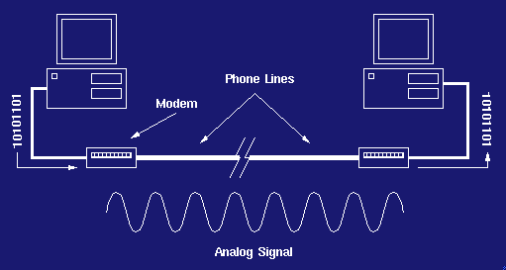
Review on Modems
Modem Stands for
  MOdulator / DEModulator
Uses Sine wave As the carrier Signal

Slide 9
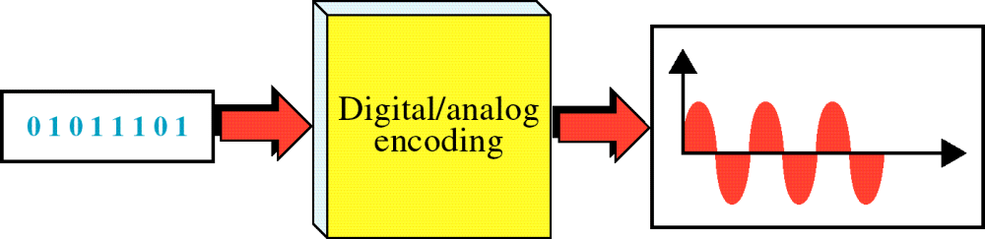
Digital to Analog Encoding
WCB/McGraw-Hill
© The McGraw-Hill Companies, Inc., 1998

Slide 10
Modulation
Need to Encode Digital Data in an Analog Signal
In modem transmission we use different techniques for modulation
  Amplitude Modulation
  Frequency Modulation
  Phase Shift

Slide 11
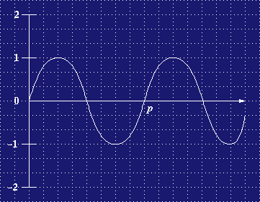
Amplitude Modulation
Varies the Amplitude of the Signal

Slide 12
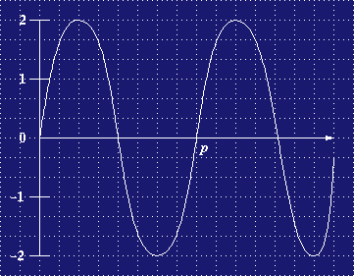
Amplitude Modulation
Same Signal Greater Amplitude
Amplitude = 1
Amplitude = 2

Slide 13
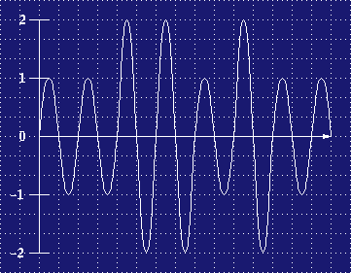
Amplitude Modulation
Amplitude 2 = 1
Amplitude 1 = 0
This signal Represents:
  0011010

Slide 14
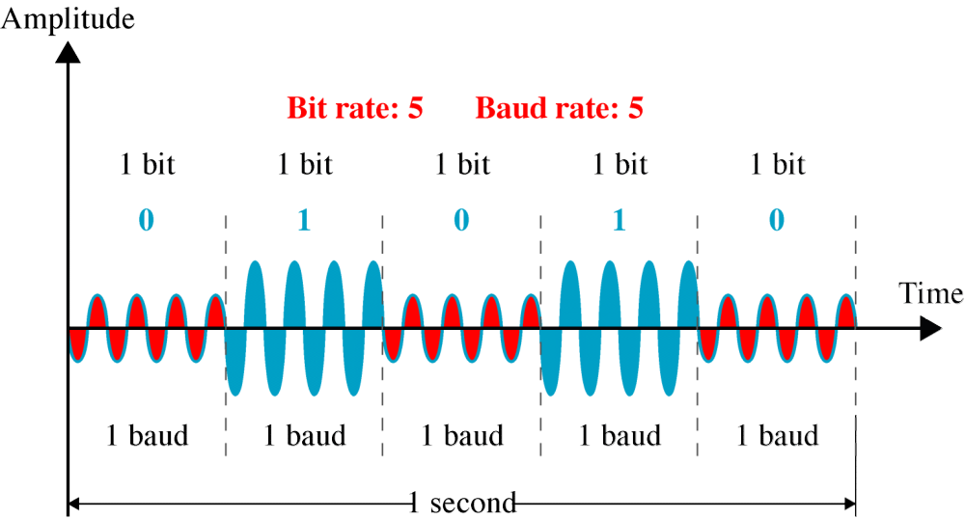
ASK
WCB/McGraw-Hill
© The McGraw-Hill Companies, Inc., 1998

Slide 15
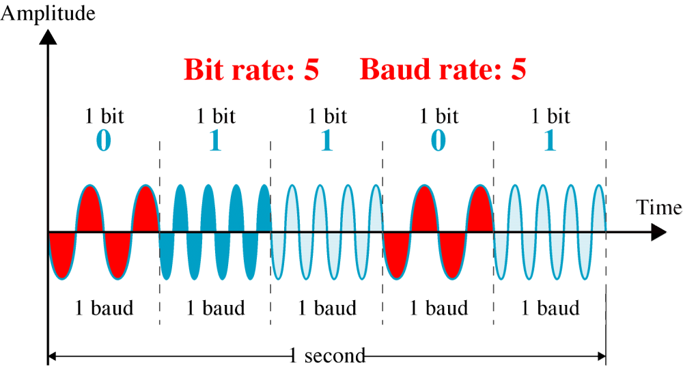
FSK
WCB/McGraw-Hill
© The McGraw-Hill Companies, Inc., 1998

Slide 16
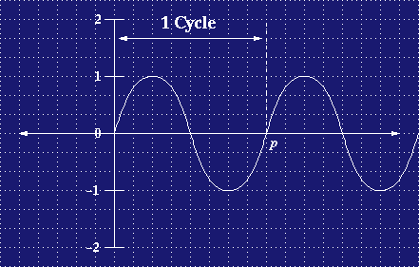
Phase-Shift Modulation
Start with our normal sine wave
The sine wave has a period of P
  P may be denoted as T instead in the equations

Slide 17
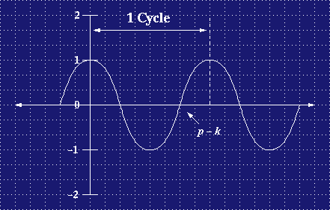
Phase-Shift Modulation
Shift the Phase of the Sine Wave
Shifted diagram shows that the cycle starting at 1 vs. starting at 0

Slide 18
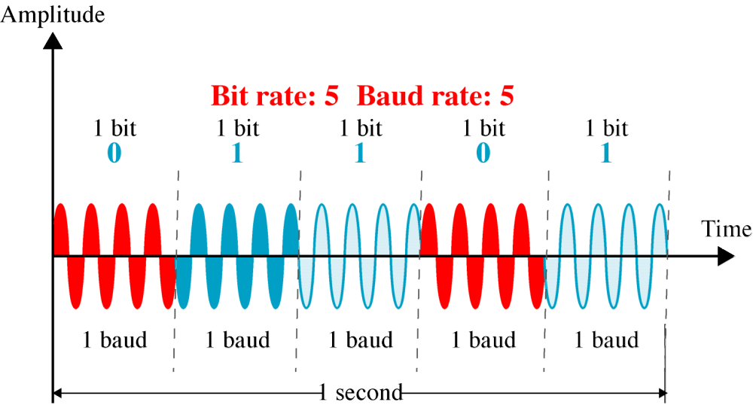
PSK
WCB/McGraw-Hill
© The McGraw-Hill Companies, Inc., 1998

Slide 19
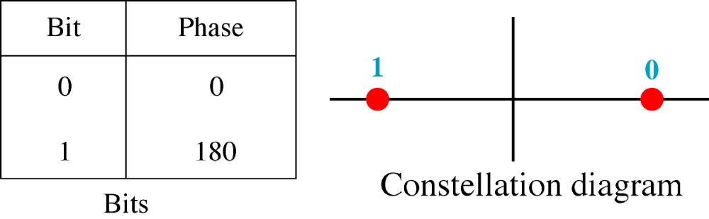
PSK
Constellation
WCB/McGraw-Hill
© The McGraw-Hill Companies, Inc., 1998

Slide 20
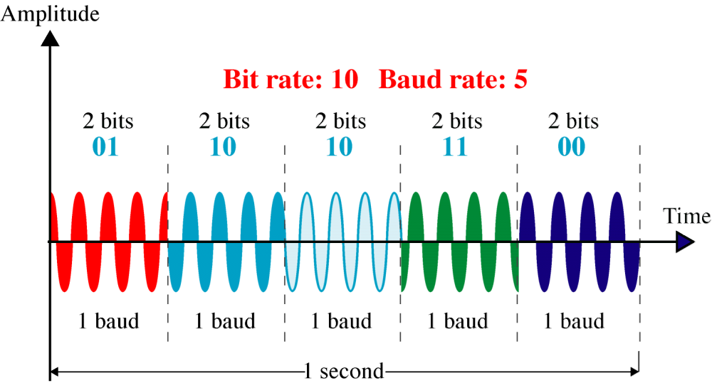
4-PSK
WCB/McGraw-Hill
© The McGraw-Hill Companies, Inc., 1998

Slide 21
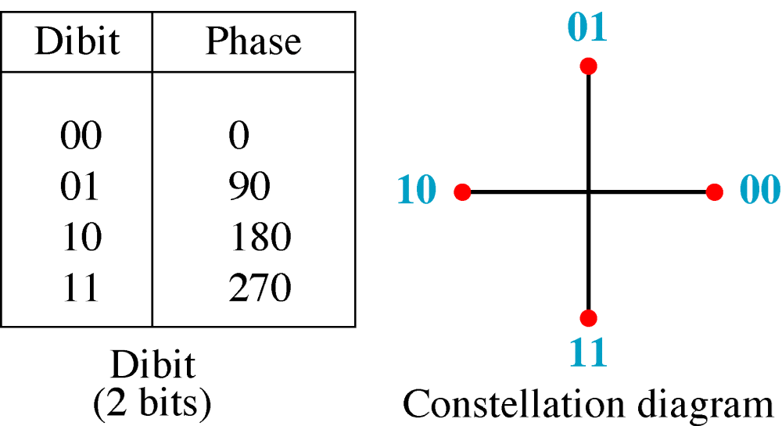
4-PSK
Constellation
WCB/McGraw-Hill
© The McGraw-Hill Companies, Inc., 1998

Slide 22
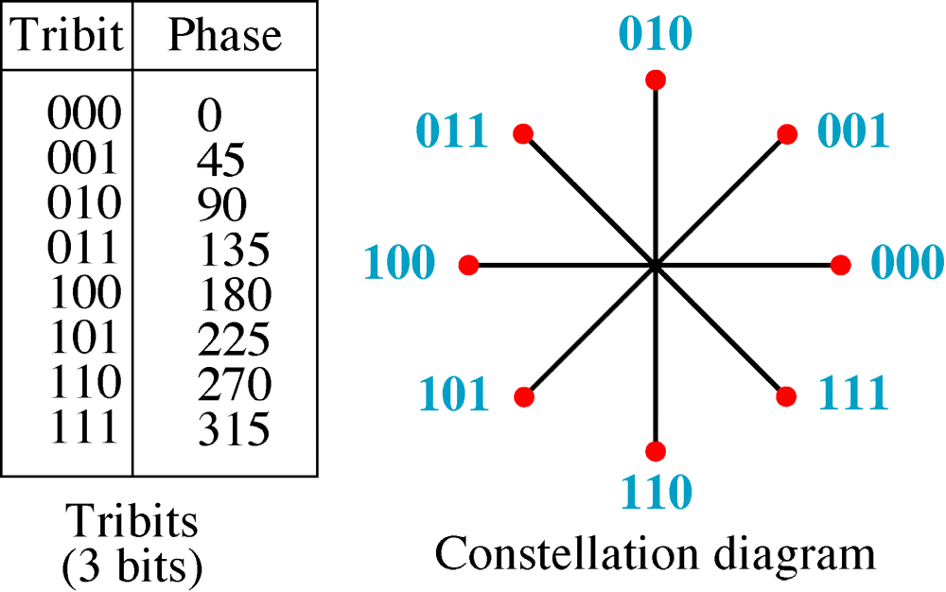
8-PSK
Constellation
WCB/McGraw-Hill
© The McGraw-Hill Companies, Inc., 1998

Slide 23
PSK
WCB/McGraw-Hill
© The McGraw-Hill Companies, Inc., 1998

Slide 24
Combining Both
Modulation used in Modern Modems
  Uses:
    Amplitude Modulation
    Phase Shift Keying
QAM
  Quadrature Amplitude Modulation
    Big Name – Simple Concept

Slide 25
QAM - Encoding
How do we Encode Messages
Take for Example: 001010100011101000011110
Bit value
Amplitude
Phase shift
Take a bit-stream of 3 bits at a time and encode
000
1
None
001
2
None
010
1
π /4
011
2
π /4
100
1
π /2
101
2
π /2
110
1
3π /4
111
2
3π /4

Slide 26
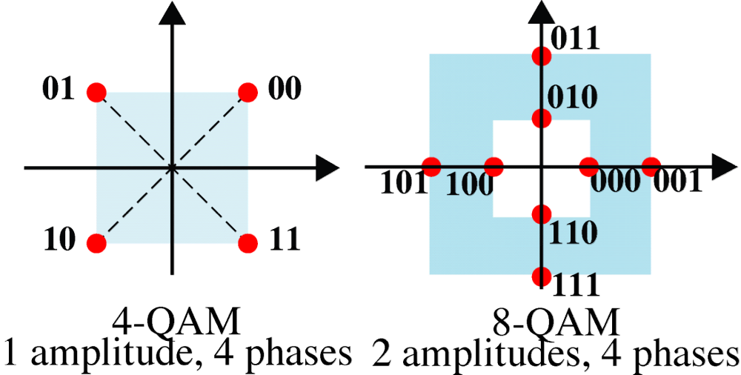
4-QAM and 8-QAM
Constellation
WCB/McGraw-Hill
© The McGraw-Hill Companies, Inc., 1998

Slide 27
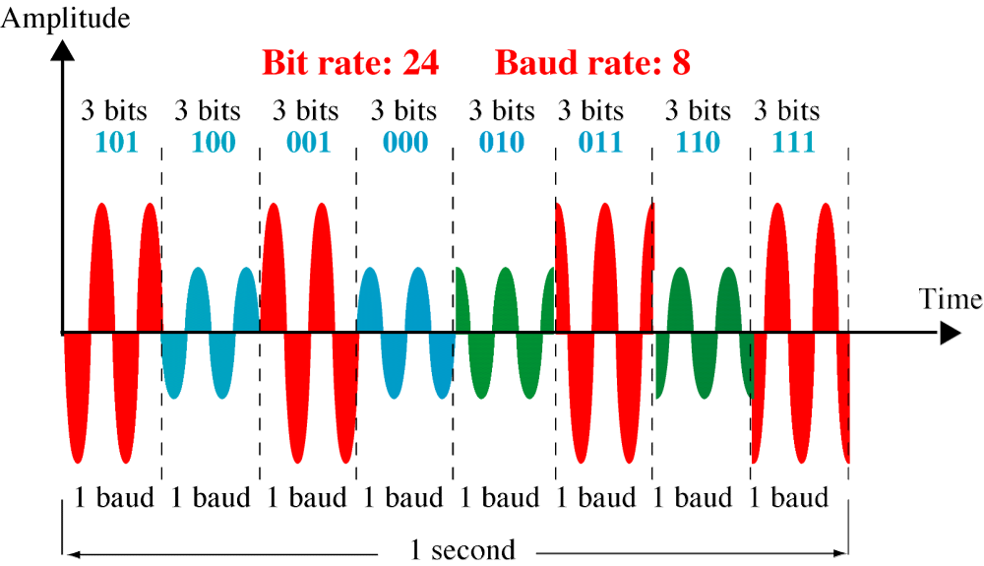
8-QAM Signal
WCB/McGraw-Hill
© The McGraw-Hill Companies, Inc., 1998

Slide 28
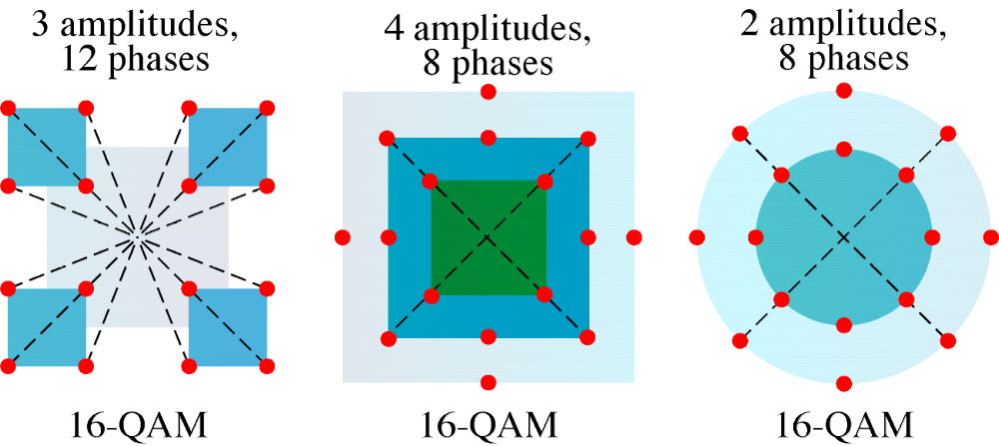
16-QAM
Constellation
WCB/McGraw-Hill
© The McGraw-Hill Companies, Inc., 1998

Slide 29
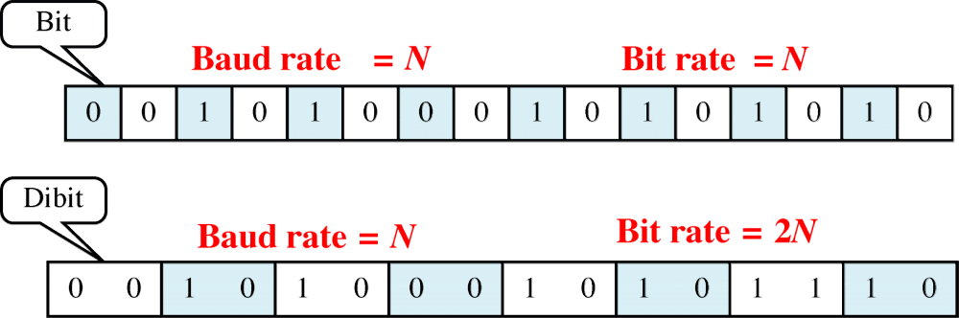
Bit Rate and Baud Rate
WCB/McGraw-Hill
© The McGraw-Hill Companies, Inc., 1998

Slide 30
Problem #3
A modem uses an 8-PSK modulation scheme supporting data rate of 4800 bps. What is the signaling rate (aka baud rate)?
8 PSK – (Phase Shift Keying)
  8 different encoding levels
  Each encoding has log₂ 8 = 3 bits
  4800 / 3 = 1600 Baud Rate

Slide 31

Problem #4
Compare the maximum data rate of a noiseless 4 kHz channel using
  A) Analog encoding with 2 bits per sample
  B) The T-1 PCM system

Slide 32

Continued
A) What do we know?
  B = 4 kHz
  n = 2 bits (per sample)
  Noiseless channel
  So we should use Nyquist theorem
    C = 2 x B x log ₂ 2^{n} = 2 x B x n
    C = 2 x 4 KHz x 2 = 16000 bps = 16 Kbps

Slide 33

Continued
B) T-1 PCM System
  8000 samples per second
  n = 8 bits
  Noiseless channel
  So we should use Nyquist theorem
    C = 2 x B x n = Sampling rate x n
    C = 8000 x 8= 64 Kbps
  The difference between 8 bits and 2 bits in (B) and (A)
    64 kbps vs. 16 kbps

Slide 34
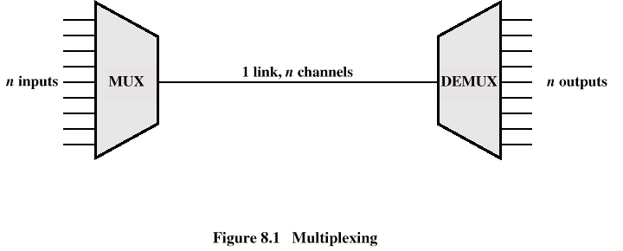
Ways of Multiplexing/Demultiplexing
Time Division Multiplexing (TDM)
You have n input lines coming in
The same # of lines going out..
Only one line interconnecting. How?

Slide 35
Packing the Data In
Multiplexing – A way of aggregating data onto a single line without compromising the rate at which original data is sent.
We are not limiting anyone's channel capacity
We are simply sending there signal through a shared line

Slide 36
Sharing – by time slots
Sample the Line 1 – Place its value in slot 1
Sampling the Line – and Send its value on its way
Line1
Line2
Line3
Slot1
Line4

Slide 37
More Time Slots
Line 2 Places its Sample on the Line
And it goes on…
Line1
Line2
Line3
Slot2|Slot1
Line4

Slide 38
Other Side - Demultiplexing
Similar to Multiplexing just the reverse
Line1
Line2
Slot2|Slot1
Line3
Line4
Line1
Line2
Slot2
Line3
Line4

Slide 39
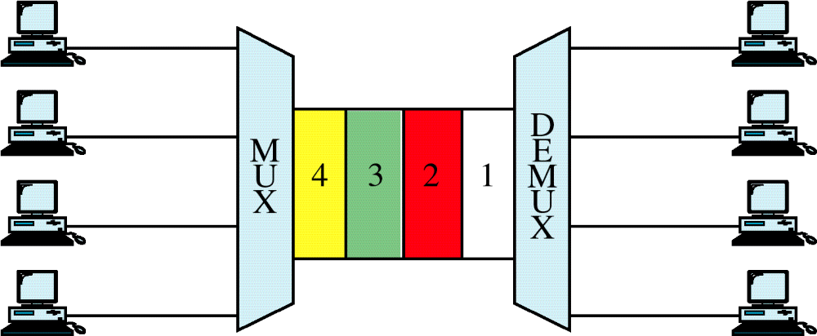
TDM
WCB/McGraw-Hill
© The McGraw-Hill Companies, Inc., 1998

Slide 40
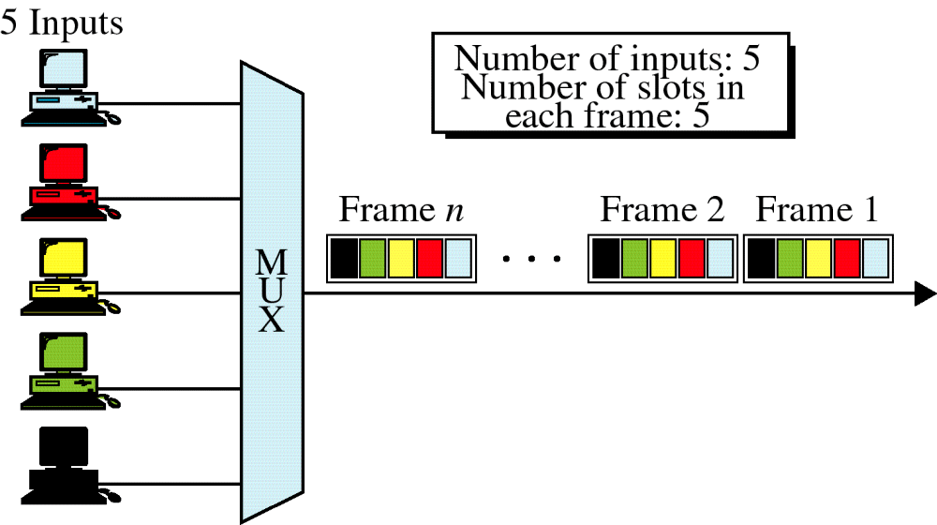
Synchronous TDM
WCB/McGraw-Hill
© The McGraw-Hill Companies, Inc., 1998

Slide 41
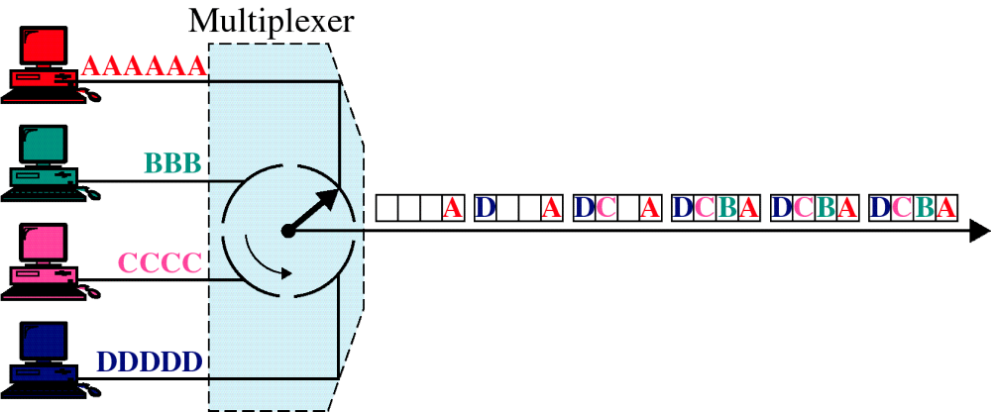
TDM, Multiplexing
WCB/McGraw-Hill
© The McGraw-Hill Companies, Inc., 1998

Slide 42
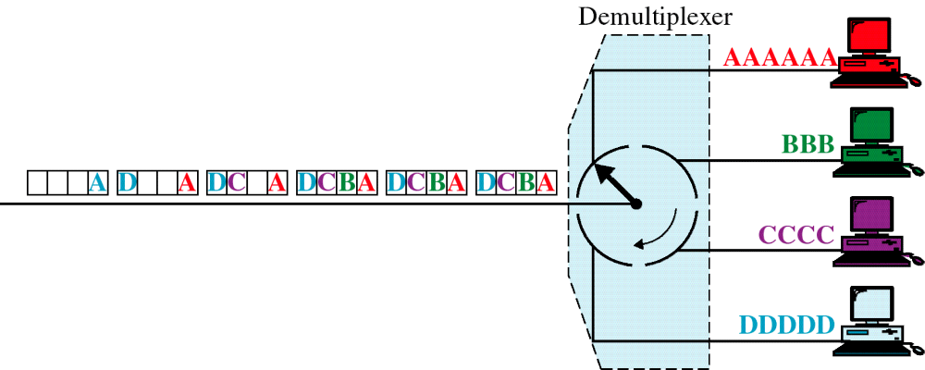
TDM, Demultiplexing
WCB/McGraw-Hill
© The McGraw-Hill Companies, Inc., 1998

Slide 43
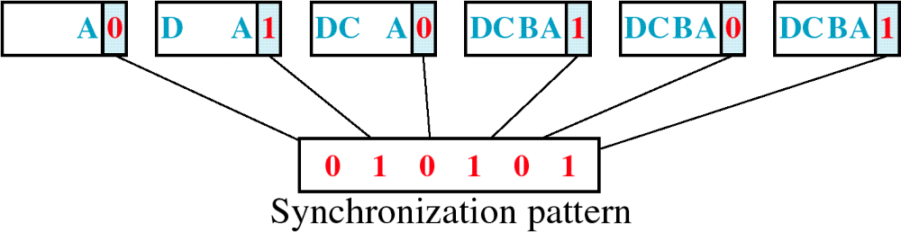
Framing Bits
WCB/McGraw-Hill
© The McGraw-Hill Companies, Inc., 1998

Slide 44
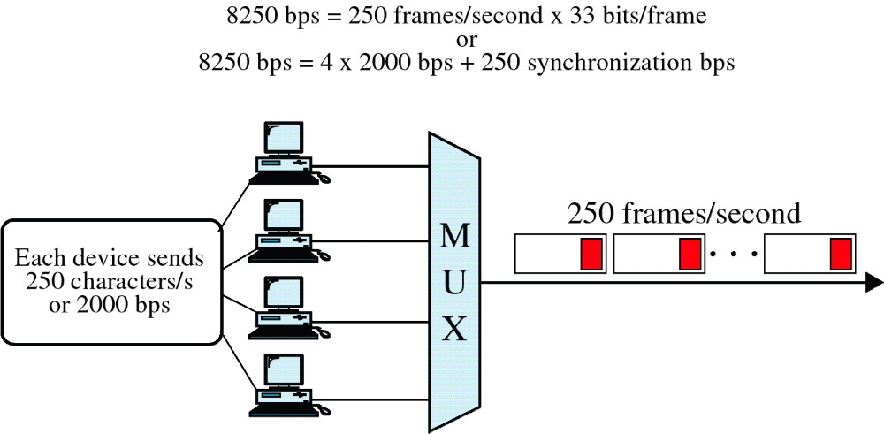
Data Rate
WCB/McGraw-Hill
© The McGraw-Hill Companies, Inc., 1998

Slide 45
TDM - Example
T-1 Lines
  Carries the equivalent of 24 voice lines
  Each analog voice line is sampled at 8000 times a second
  Digital Sample is thrown on the Digital Carrier Line
  On the other side Digital samples are used to reconstruct Analog Signal.

Slide 46
STDM (Asynchronous TDM)
How does it Work?
  Checks to see if there is data to transmit on input line
    If there is transmit data
    If not move on to next input line

Slide 47
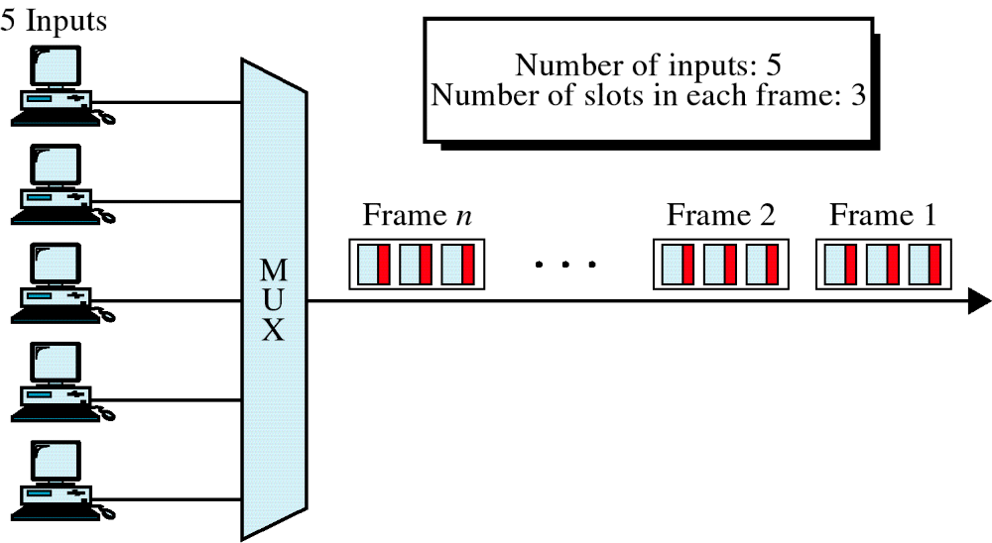
Asynchronous TDM
WCB/McGraw-Hill
© The McGraw-Hill Companies, Inc., 1998

Slide 48
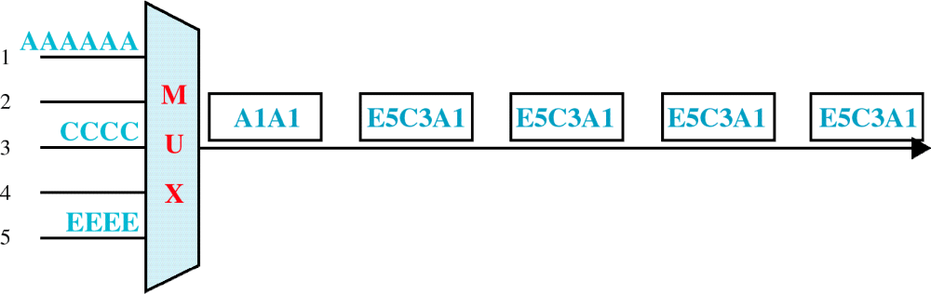
Frames and Addresses
a. Only three lines sending data
WCB/McGraw-Hill
© The McGraw-Hill Companies, Inc., 1998

Slide 49
TDM vs. STDM
Synchronous TDM – Gray Slots are actually carrying data
Slot 1
Slot 2
Slot 3
Slot 4
Slot 1
Slot 2
Slot 3
Statistical TDM – Uses empty time slots but does add some overhead
Slot 1
Slot 2
Slot 1
Slot 2
Slot 3
Slot 1

Slide 50
Notes on TDM
Sampling Occurs very quickly
Applicable to fixed number of flows
Requires Precise Timing
Resources are guaranteed

Slide 51
STDM
Statistical Time Division Multiplexing
Similar to regular TDM but different in this:
  Traffic is sent on demand – Only if there is data on line 1, will slot 1 be occupied by line 1
  Resources are not guaranteed
If we are no longer guaranteed a time slot why use it?
  We (the carrier) can take advantage of one of the input lines not being busy
Important distinction – STDM is used mainly for Digital Lines

Slide 52
TDM vs. STDM
Resources are guaranteed to the users
Sampling Occurs very quickly
Applicable to fixed number of flows
Requires Precise Timing
Wastes valuable carrier space
Traffic is sent on demand utilizing unused time slots so it benefits the Carrier
Resources are not guaranteed so when time slots are busy the users suffer
In real life there is some overhead
Speedup isn’t as obvious

Slide 53
Statistical TDM Parameters
  I = Number of Input Sources
  R = Data rate of each source (bps)
  α (Alpha) = mean fraction of time each source is transmitting
  M = Effective capacity of multiplexed line
  K = M / (I x R) = Ratio of multiplexed line capacity to total input rate
  λ (lambda) = α x I x R = Average Arrival time
  T_{s} = 1 / M = Service time in seconds

Slide 54
ρ : Line Utilization
ρ = Fraction of total link capacity being used
Many different forms to express line utilization
  ρ = λ T_{s}
  ρ = (α x I x R) / M
  ρ = α / K
  ρ = λ / M

Slide 55
Sample Problem #5
Ten 9600 bps lines are multiplexed using TDM. Ignoring overhead bits what is the total capacity required for Synchronous TDM?
  Simple: 10 X 9600 = 96 kbps (96,000)

Slide 56
Sample Problem #6
Ten 9600 bps lines are multiplexed using TDM. Assuming that we limit line utilization to 0.8 and each line is busy 50 % of the time. What is the capacity required for Statistical TDM?
  What do we know?
    Line utilization – ρ = .8
    Fraction of time transmitting - α = .5
    R Data Rate of each input source = 9600 bps
    I number of Input Sources = 10

Slide 57
Continued
The Equation:
ρ = α x I x R x /M
  Where M is the capacity of the multiplexed line
Rearrange for M
  M = α x I x R / ρ
Plug in the given parameters
  M = 0.5 x 10 x 9600 / 0.8
  M = 60 kbps

Slide 58
Sample Problem #7
Calculate the capacity of a Multiplexed carrier?
  24 voice channels multiplexed
  8000 samples per second
    Each frame lasts 1/8000 = 125 µ sec
  Uses 8 bit encoding per sample
  Capacity
    24 X 8000 samples/second X 8 bits/sample
    1,536,000 bits/second
  T-1 Adds an extra bit per frame (for synchronization) which makes it 1.544 Mbps

Slide 59
Sample Problem #8
What is the percent overhead on a T-1 Carrier?
  T-1 Carrier bandwidth of 1.544 Mbps
    Every 192 bits one more bit is added for framing.
  What is the overhead?

Slide 60

Continued
Overhead in a T-1 Line
  Every frame consists of 193 bits
  24 X 8 = 192 bits
  193-192 = 1 overhead bit
  1/193 = .5%

